Slide 1
Cures Update: Single Patient API
Brittany Brown
Lead Solution Designer | Open Platform Engineering
November 13, 2020

Slide 2
A seamless and connected world
where everyone thrives
Cerner Vision

Slide 3
Open Platform Vision
010111 10110001 000111001101
Accelerate Health Care Innovation and
Foster Data Interoperability by
Enabling a Global Community to Amplify the Power of Cerner’s Open Platforms
010111 10110001 0010111 10110001
Enable Organizations to Share Information
> > > > > > > > > > >

Slide 4
Agenda
Background
FHIR Resources
Prerequisites
Roadmap
Validation
References

Slide 5
Background

Slide 6
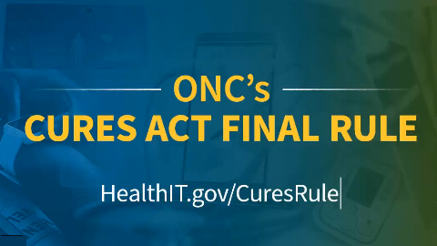
Background: What is it?
Updated requirements for Health IT vendors and developers
Certification Updates
“2015 CEHRT Cures Updates”
Information Blocking*
Patient Access
New Certification Criteria
Revised Certification Criteria
Removed and Time-Limited Certification Criteria*
*Not addressed in this presentation
Notes:
References:
https://www.healthit.gov/topic/about-onc
https://www.himss.org/resources/21st-century-cures-act-summary

Slide 7
Background: What is it?
Certification Updates: 2015 CEHRT Cures Updates
New Certification Criteria
§ 170.315(b)(10) Electronic Health Information (EHI) Export*
§ 170.315(g)(10) Standardized API for Patient and Population Services
Revised Certification Criteria
Two new privacy and security certification criteria*
Removed and Time-Limited Certification Criteria*
Standards Revision*
USCDI Updates
*Not addressed in this presentation
Notes:
References:
https://www.healthit.gov/curesrule/final-rule-policy/2015-edition-cures-update

Slide 8
Background: What is it?
Patient Access
Patient’s Ease of Access to Their Chart
Smartphones
Protecting Patient Privacy and Security*
Providing the Ability to Shop for Care and Manage Costs*
Modern Software Apps
*Not addressed in this presentation
Notes:
References:
https://www.healthit.gov/curesrule/final-rule-policy/empowering-patients-us-health-care-system

Slide 9




Background: Who’s The Boss
New Certification Criteria
Standardized API for Patient Services
Revised Certification Criteria
USCDI Updates
Others
Notes:
References:
http://build.fhir.org/ig/HL7/US-Core-R4/general-guidance.html#us-core-data-for-interoperability-and-2015-edition-common-clinical-data-set

Slide 10

Background: Who’s The Boss
Cerner Ignite APIs

Slide 11
FHIR Resources

Slide 12
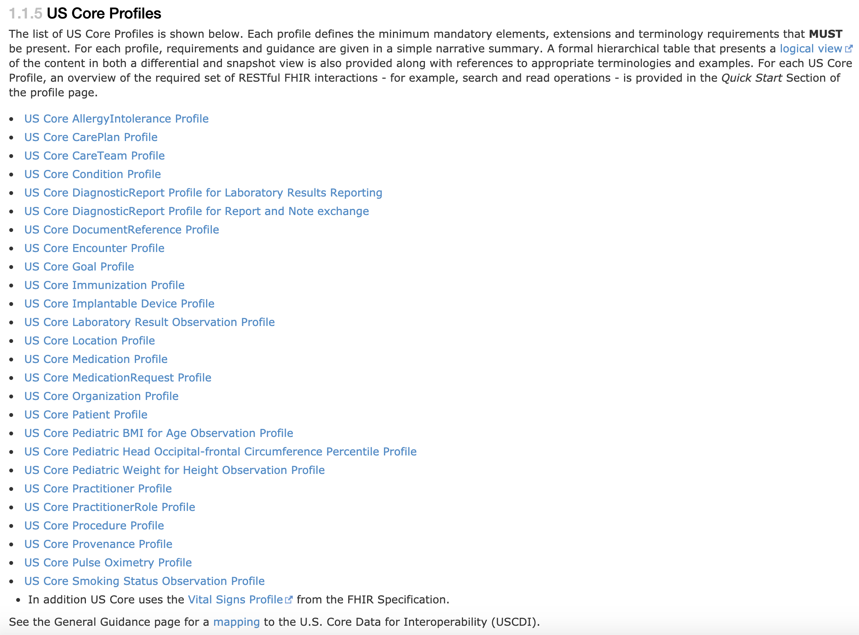
FHIR Resources: US Core

Slide 13
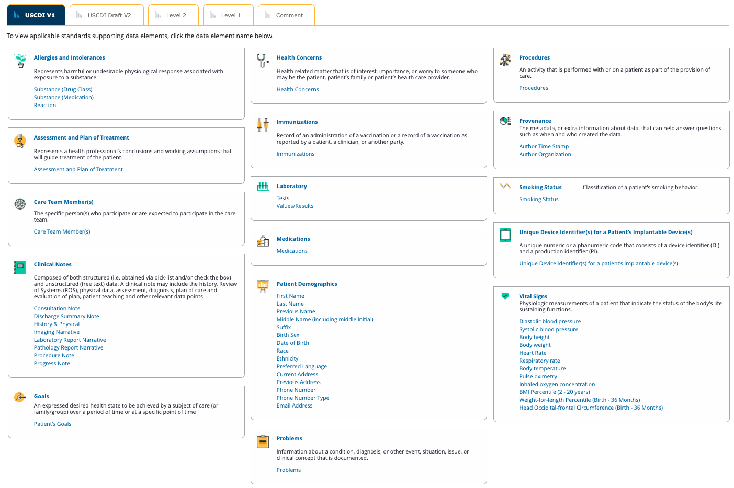
FHIR Resources: USCDI
Notes:
References:
https://www.healthit.gov/isa/united-states-core-data-interoperability-uscdi

Slide 14
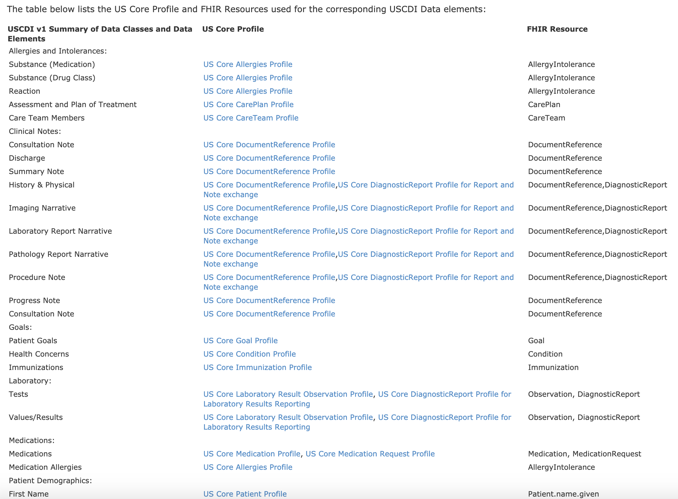
FHIR Resources: Requirements Profile Matrix
Notes:
References:
http://build.fhir.org/ig/HL7/US-Core-R4/general-guidance.html#us-core-data-for-interoperability-and-2015-edition-common-clinical-data-set

Slide 15
Prerequisites

Slide 16
Prerequisites
Summary
Developers: HL7 FHIR R4
Clients: FHIR API R4 Mappings
Clients: Code Level
Clients: Foundational Configuration

Slide 17

Prerequisites
FHIR API R4 mappings
Overview
Mapping of local/proprietary codes for clinical data to required vocabulary standards to ensure conformant API responses
Who?
Performed by Cerner as part of Ignite API licensing (no engagement necessary)
When?
Mapping work is already underway but will continue through summer 2022 for full scope of FHIR resources

Slide 18

Prerequisites
Millennium code upgrade
Overview
Uplifting to new required Millennium code base of 2018.08
Who?
Can be performed via Cerner Upgrade Center services or client-owned (if using Upgrade Center, engage w/ CAE or submit a slotting request here)
When?
June 2021 – June 2022 (upgrade project = ~14 weeks)

Slide 19

Prerequisites
FHIR API configuration
Overview
Various system configurations to ensure all required data is available for FHIR API responses in accordance with the standard specifications
Who?
Can be performed via Regulatory Consulting Services or client-owned (if seeking services, contact Katie Batliner (katie.batliner@cerner.com)
When?
January 2021 – July 2022 (some work can be started on your own now – see Resources slide)

Slide 20
Roadmap

Slide 21
543 days
412 days
348 days
283 days
283 days
196 days
150 days
Roadmap
Millennium 2018.08 GA Release
CMS Proposed Implementation Deadline
Jul 28 '21
Aug 2 '22
Oct 1 '21
Cures Updates Cloud Deployments
Apr 30 '22
2020
Jul
Oct
2021
Apr
Jul
Oct
2022
Apr
Jul
2022
Today
Jul 1 '20
FHIR API R4 Mappings Work
Aug 1 '22
Jun 1 '21
2018.08 Millennium Code Upgrades
Jun 30 '22
Jan 1 '21
FHIR API Configuration
Aug 1 '22

Slide 22
Roadmap
Iterative Production Releases
Incremental Value
Receive Feedback

Slide 23
Validation

Slide 24


Slide 25
References

Slide 26
References
Cerner
Cerner Ignite APIs for Millennium Release Notes
Implement Cerner Ignite APIs for Millennium
Code Portal
Google Group
FHIR.Cerner.com
Follow uCern Regulatory Engagement Group (REG) for updates
Cerner Cures Act Final Rule White Paper

Slide 27
References
Industry
ONC Cures Act Final Rule Policy
HealthIT.gov
US Core Profiles
US Core Data for Interoperability and 2015 Common Clinical Data Set
USCDI
Inferno

Slide 28


Thank you.
Brittany Brown
Brittany.Brown@Cerner.com

